Slide 1
Cellular Automata Life
A model by Richard Hanes

Slide 2
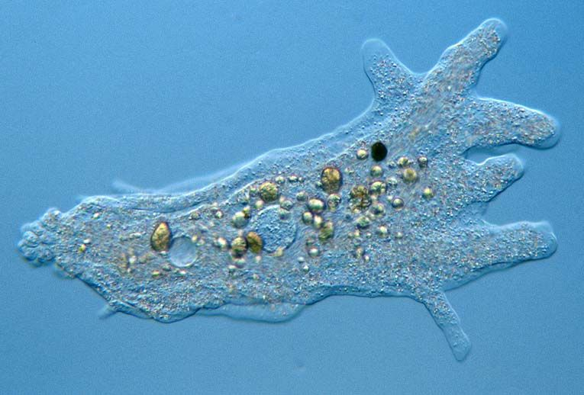
Overview
Project Outline
Rules of the Model
Interesting Algorithms
Next Steps
Project Roadmap

Slide 3
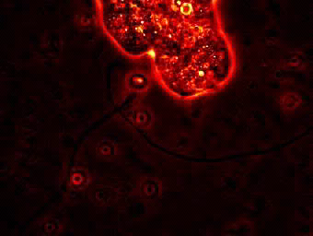
Project Outline
Model the growth of a microbial system using cellular automation
Resource diffuses in from the boundary
Movement and Growth dependant on size and resource

Slide 4
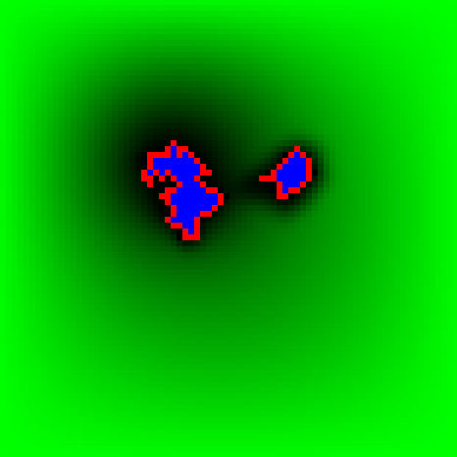
Rules - Food
Resource diffuses in from the boundary
Resource diffuses into but not out of Amoebas
Resource cannot diffuse between different Amoebas
Each Amoeba consumes some Resource per iteration

Slide 5
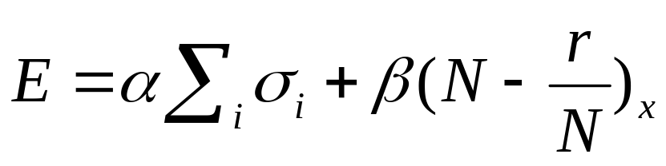
Rules - Dynamics
Probability of changing state given by p = exp(E)
If p>1 Amoeba shrinks with probability (1-1/p)
If p<1 Amoeba grows with probability (1-p)
α - Shape Constant
β - Size Constant
σ = 1 for Amoeba sites, -1 for bare-ground sites
N_{x} – Size of Amoeba x
r_{x} – Resource of Amoeba x
Sum runs over the 4 nearest neighbours

Slide 6
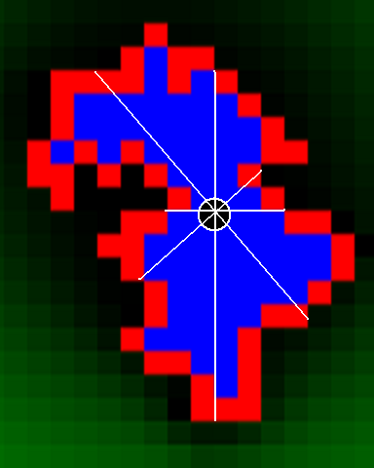
Cell Division Algorithm
Find Centre of Mass
Draw 4 lines separated by 45º
Find the line which covers the least Amoeba
Convert all sites on one side of the line to a new Amoeba

Slide 7
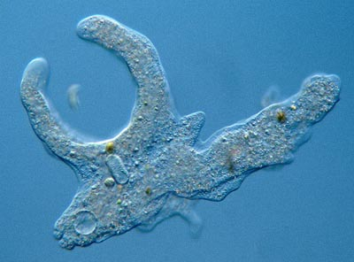
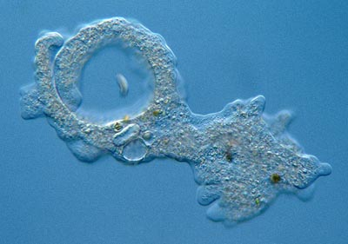
Next Steps
Implement Cell division
Give each Amoeba a Nucleus site to which all other sites must be connected
Incorporate resource sensing into the Dynamics rules

Slide 8
Roadmap
Add evolutionary behaviour
Include a ‘Poison’ field and try to recreate UV Umbrella experiments
Extend to 3D and try to recreate the slug

